Slide 1


Creating Art with Computer Programming
Phillipa Gill, Ivan Lee and Tauhidur Rahman
College of Information and Computer Sciences
UMass Amherst

Slide 2

Sponsors

Slide 3
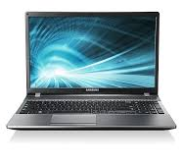
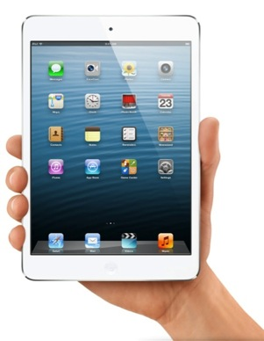
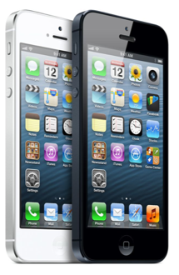


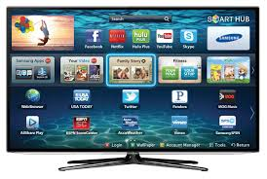
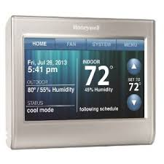
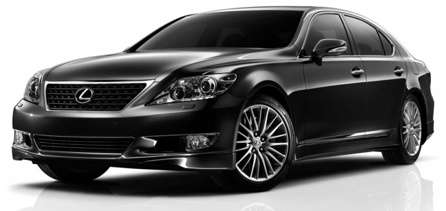

Slide 4







Slide 5
Technology can also be used to create!

Slide 6

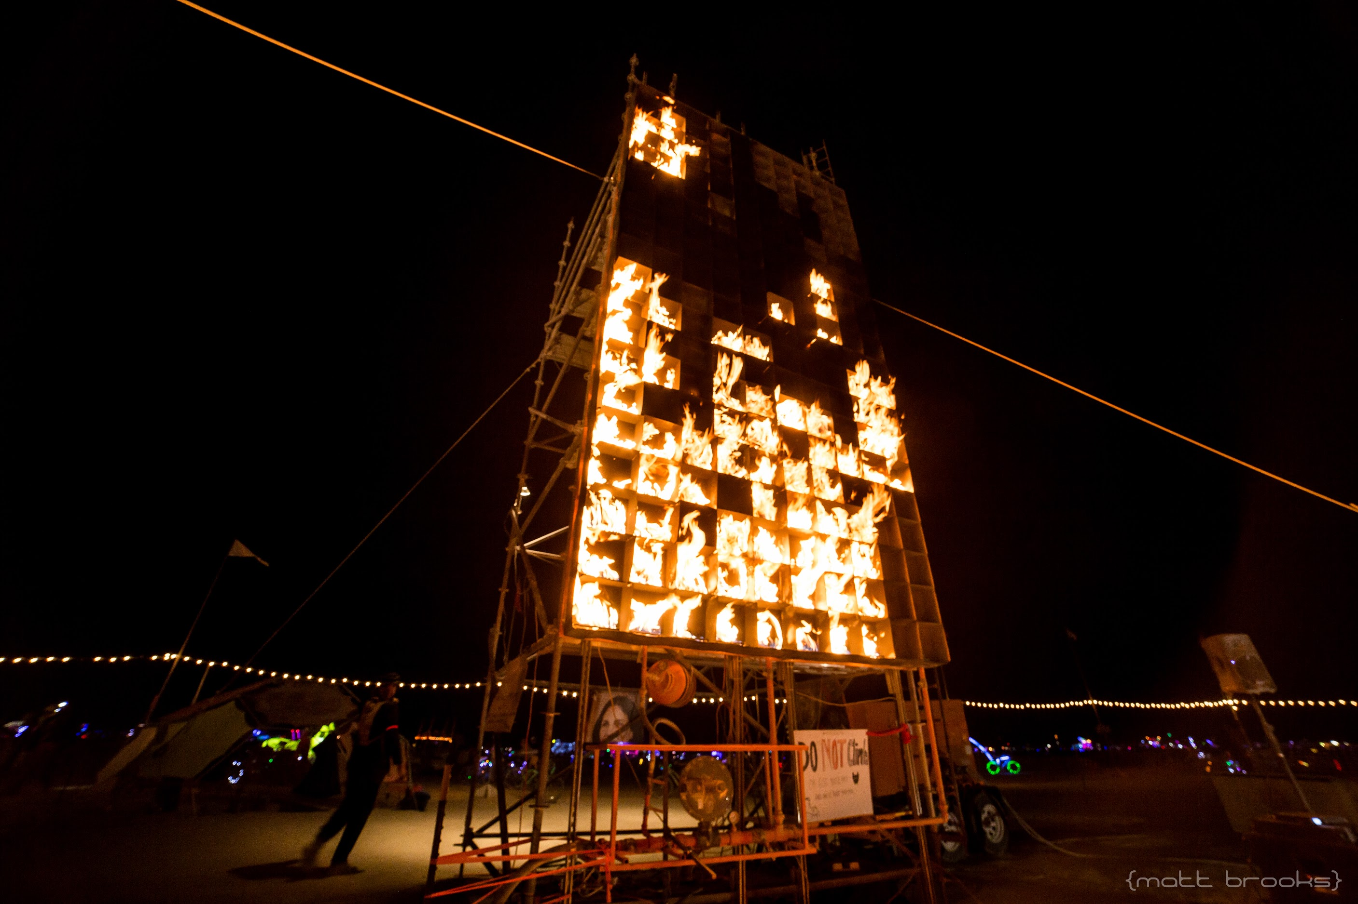
Technology can also be used to create!
Fire Tetris 2015
https://www.youtube.com/watch?v=MgMMcycRkBI

Slide 7

Technology can also be used to create!

Slide 8
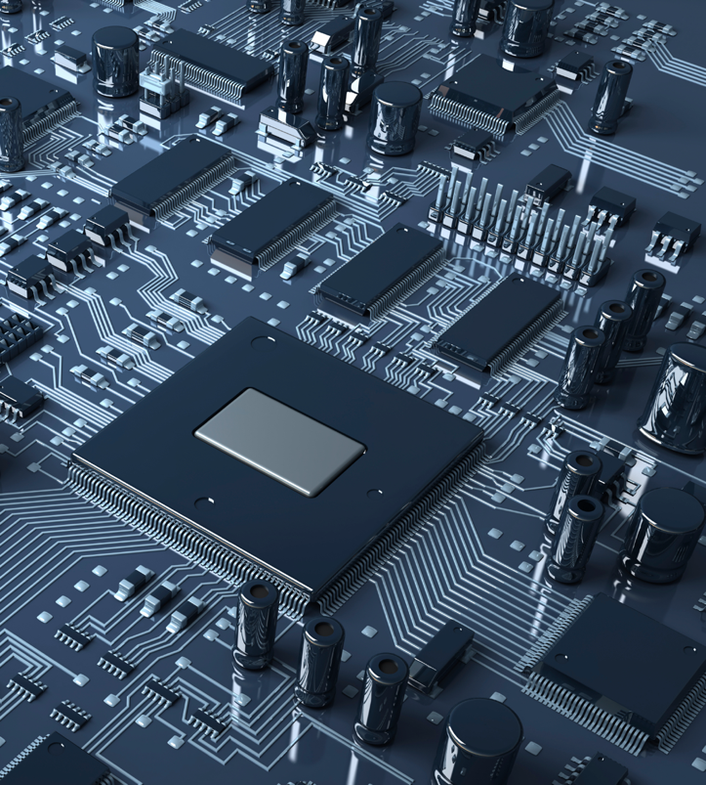
What is Programming?
Add 010100000000
Load A 010101000000
Divide 010111000000
Extract 011000000000
Load F 011001000000
Store F 011010000000
Store A 011011000000
Store X 100100000000
Move A 100101000000
Load L 100110000000
Multiply 100111000000
Subtract 110101000000
Notes:
How to tell the computer what to do?

Slide 9
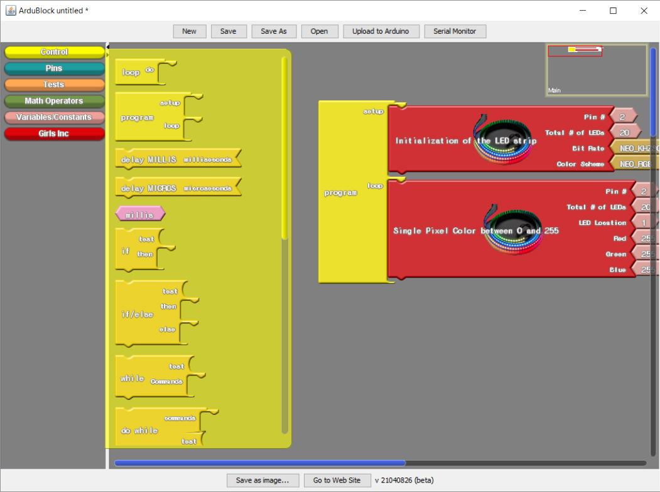
Block Categories
Blocks
Code

Slide 10
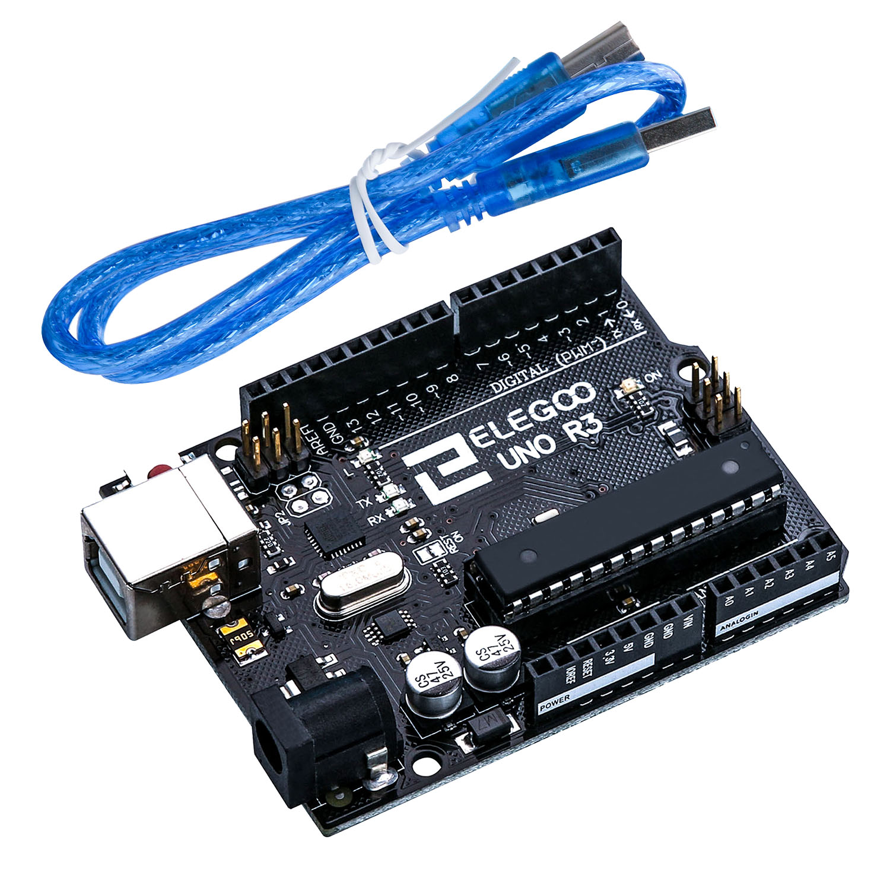
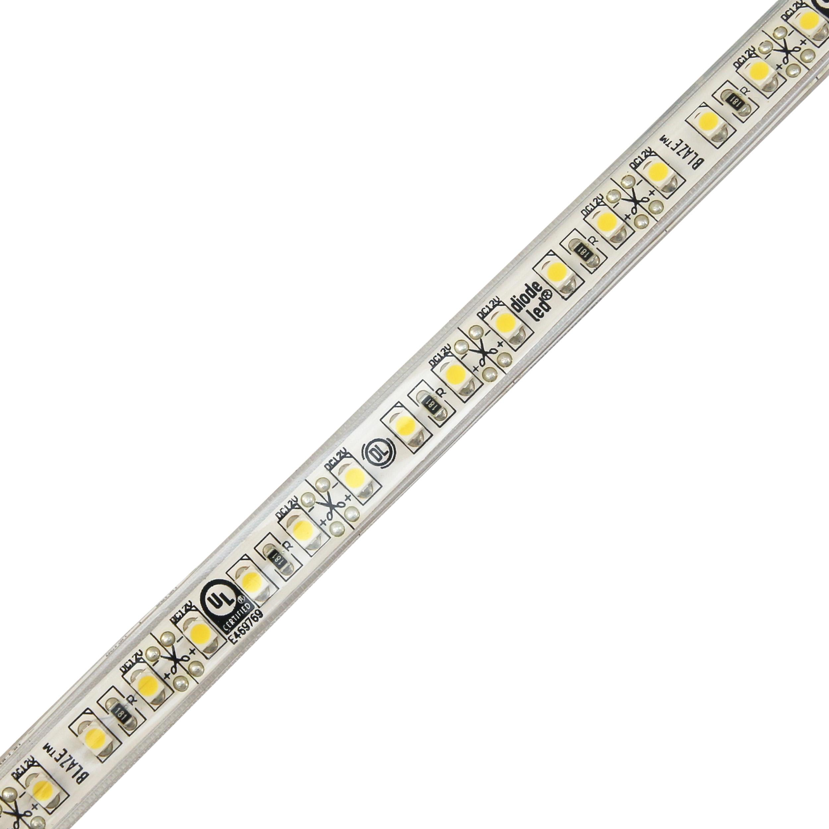
Arduino
LED strip

Slide 11
Brain
(software)
Body
(hardware)
Tool
(sensor)

Slide 12
Demo

Slide 13
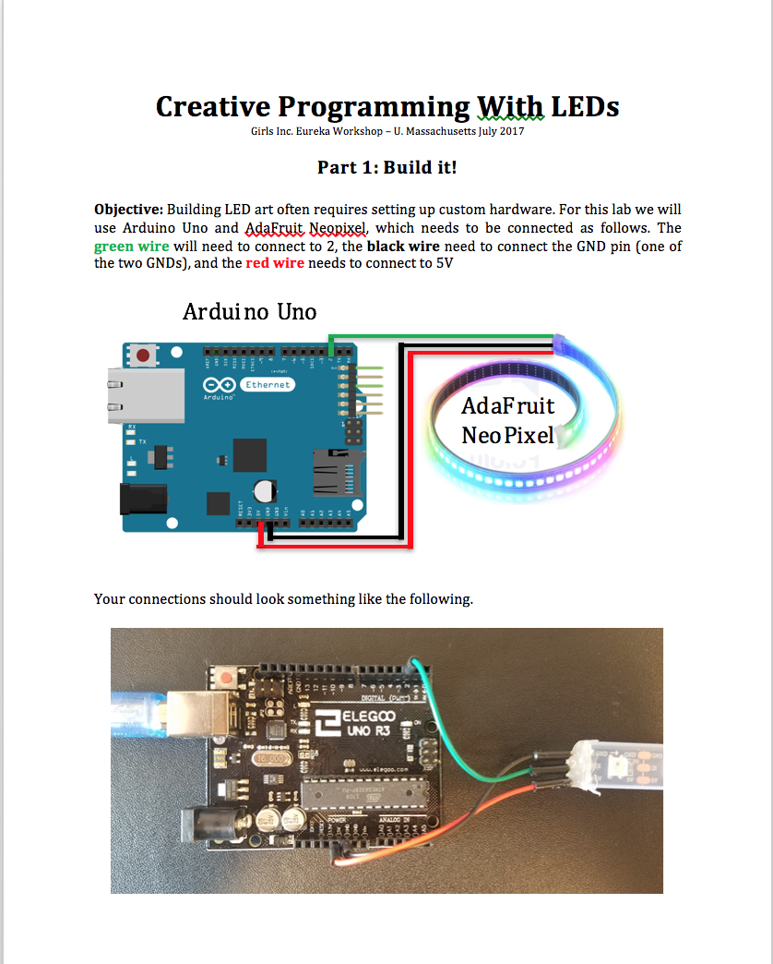
Instructions

Slide 14
Work Together
Ask Questions
Have Fun!

